Slide 1
Augmenting AVL trees

Slide 2
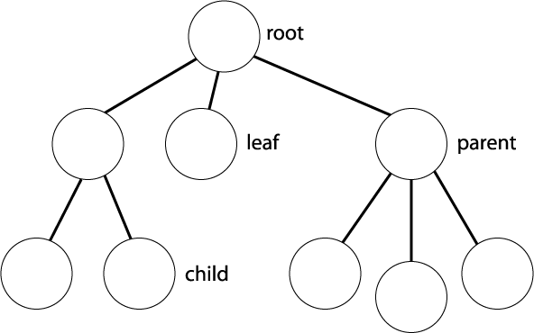
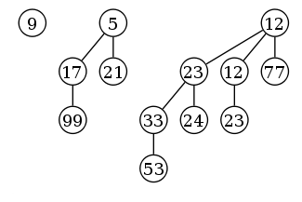
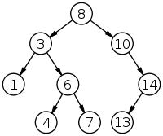
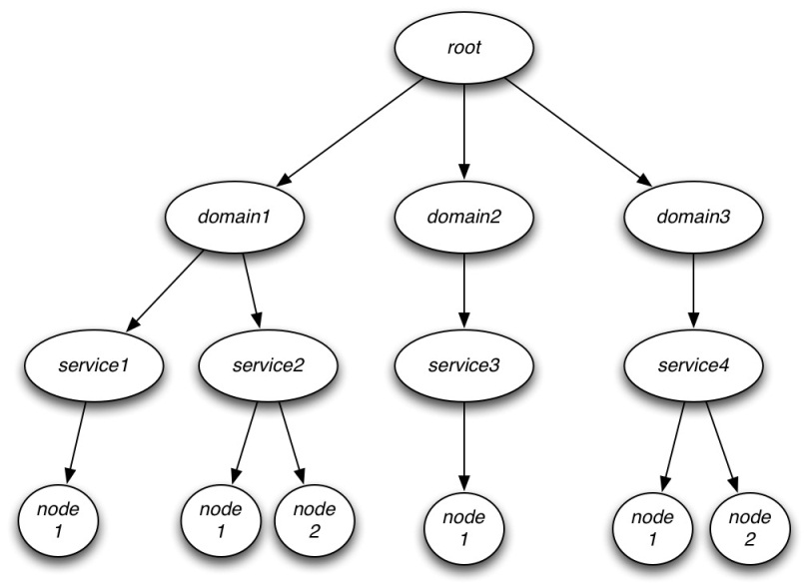
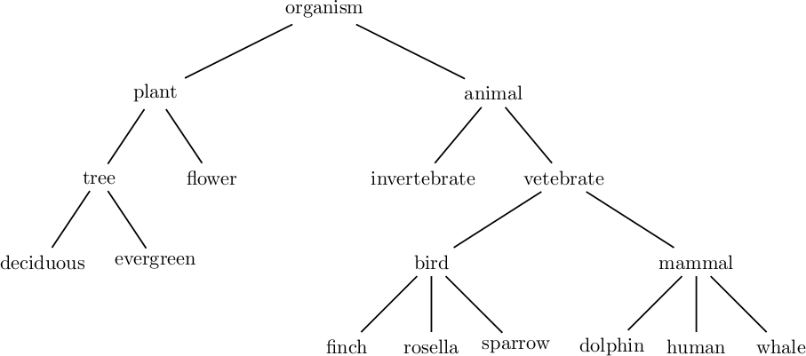
How we’ve thought about trees so far
Good for determining ancestry
Can be good for quickly finding an element

Slide 3
Other kinds of uses?
Any thoughts?
Finding a minimum/maximum…
(heaps are probably just as good or better)
Finding an average?
More complicated things?!!!11one
Enter: idea of augmenting a tree

Slide 4
Augmenting
Can quickly compute many global properties that seem to need knowledge of the whole tree!
Examples:
size of any sub-tree
height of any sub-tree
averages of keys/values in a sub-tree
min+max of keys/values in any sub-tree, …
Can quickly compute any function f(u) so long as you only need to know f(u.left) and f(u.right)!

Slide 5
Augmenting an AVL tree
Can augment any kind of tree
Only balanced trees are guaranteed to be fast
After augmenting an AVL tree to compute f(u), we can still do all operations in O(lg n)!

Slide 6
Simple first example
We are going to do one simple example
Then, you will help with a harder one!
Problem: augment an AVL tree so we can do:
Insert(key): add key in O(lg n)
Delete(key): remove key in O(lg n)
Height(node): get height of sub-tree rooted at node in O(1)
A regular AVL tree already does this
Store some extra data at each node… but what?
How do we do this?

Slide 7
Can we compute this function quickly?
Function we want to compute: Height(u) = H(u)
If someone gives us H(u_{L}) and H(u_{R}), can we compute H(u)?
What formula should we use?
If u is a leaf then
H(u) = 0
Else
H(u) = max{H(u_{L}), H(u_{R})}+1
u
u_{L}
u_{R}
H(u_{L})
H(u)=?
H(u_{R})

Slide 8
Augmenting AVL tree to compute H(u)
Each node u contains
key: the key
left, right: child pointers
h: height of sub-tree rooted at u
How?
The usual stuff…
Secret sauce!
d, 0
d, 1
d, 2
d, 3
d, 1
d, 2
d, 3
Insert(d)
a, 0
a, 1
a, 2
b, 1
e, 0
b, 1
e, 0
2
Insert(a)
Insert(e)
b, 0
b, 1
c, 0
a, 0
c, 0
a, 2
Insert(b)
Insert(c)
c, 0

Slide 9
Algorithm idea:
From the last slide, we develop an algorithm
Insert(key):
1 BST search for where to put key
2 Insert key into place like in a regular AVL tree
3 Fix balance factors and rotate as you would in AVL insert, but fix heights at the same time.
(Remember to fix heights all the way to the root. Don’t stop before reaching the root!)
(When you rotate, remember to fix heights of all nodes involved, just like you fix balance factors!)

Slide 10

Harder problem: scheduling conflicts
Your calendar contains a bunch of time intervals [lo,hi] where you are busy
We want to be able to quickly tell whether a new booking conflicts with an earlier booking.

Slide 11
Breaking the problem down
You must design a data structure D to efficiently do:
Insert(D; x): Insert interval x into D.
Delete(D; x): Delete interval x from D.
Search(D; x): If D contains an interval that overlaps with x, return any such interval. Otherwise, return null.
All functions must run in O(lg n)
The hard part

Slide 12
Figuring out the data structure - 1
Iterative process; HARD to get right the first time!
Need a way to insert intervals into the tree
Use low end-point of interval as the key
Example tree:
30, 34
26, 36
60, 80
8, 16
29, 36
48, 52

Slide 13
Figuring out the data structure - 2
What function do we want to compute?
Does an interval x intersect any interval in the tree?
What info should we store at each node u?
Mhi(u) = Maximum high endpoint of any node in the subtree.
How can we use the info stored at each node to compute the desired function (by looking at a small number of nodes)?
Start by computing whether an interval x intersects any interval in a subtree.

Slide 14
Algorithm for Search within a subtree
Returns an interval in the subtree rooted at u that intersects [lo, hi]
Search(lo, hi, u):
if u is null then return null

Slide 15
Algorithm for Search within a subtree
Returns an interval in the subtree rooted at u that intersects [lo, hi]
Search(lo, hi, u):
if u is null then return null
if [lo, hi] intersects [lo(u), hi(u)] then return [lo(u), hi(u)]

Slide 16
Algorithm for Search within a subtree
Returns an interval in the subtree rooted at u that intersects [lo, hi]
Search(lo, hi, u):
if u is null then return null
if [lo, hi] intersects [lo(u), hi(u)] then return [lo(u), hi(u)]
else (no intersection)
if lo < lo(u) return Search(lo, hi, left(u))
Every node v on this side has lo(v) > hi
lo hi
lo hi
lo(u) hi(u)
u

Slide 17
Algorithm for Search within a subtree
Returns an interval in the subtree rooted at u that intersects [lo, hi]
Search(lo, hi, u):
if u is null then return null
if [lo, hi] intersects [lo(u), hi(u)] then return [lo(u), hi(u)]
else (no intersection)
if lo < lo(u) return Search(lo, hi, left(u))
else (lo ≥ lo(u))
if lo > Mhi(left(u)) then return Search(lo, hi, right(u))
u
lo(u) hi(u)
Every node v on this side has hi(v) < lo
lo hi
lo hi
k

Slide 18
Algorithm for Search within a subtree
Returns an interval in the subtree rooted at u that intersects [lo, hi]
Search(lo, hi, u):
if u is null then return null
if [lo, hi] intersects [lo(u), hi(u)] then return [lo(u), hi(u)]
else (no intersection)
if lo < lo(u) return Search(lo, hi, left(u))
else (lo ≥ lo(u))
if lo > Mhi(left(u)) then return Search(lo, hi, right(u))
else (lo ≤ Mhi(left(u))
return Search(lo, hi, left(u))
u
lo(u) hi(u)
v
lo hi
lo(v) hi(v) = Mhi(left(u))

Slide 19
Final algorithm for Search
Search(lo, hi, u):
if u is null then return null
if [lo, hi] intersects [lo(u), hi(u)] then return [lo(u), hi(u)]
else (no intersection)
if lo < lo(u) return Search(lo, hi, left(u))
else (lo ≥ lo(u))
if lo > Mhi(left(u)) then return Search(lo, hi, right(u))
else (lo ≤ Mhi(left(u))
return Search(lo, hi, left(u))
Search(D, x=[lo, hi]):
return Search(lo, hi, root(D))

Slide 20
Algorithms for Insert and Delete
Insert(D, x=[lo, hi]):
Do regular AVL insertion of key lo, also storing hi.
Set Mhi of the new node to hi.
Fix balance factors and perform rotations as usual, but also update Mhi(u) whenever you update the balance factor of a node u.
Update Mhi(u) for all ancestors, and for every node involved in a rotation, using formula: Mhi(u) = max{hi(u), Mhi(left(u)), Mhi(right(u))}.
Delete(D, x=[lo, hi]): similar to Insert

Slide 21
Why O(lg n) time?
Insert/Delete: normal AVL operation = O(lg n)
PLUS: update Mhi(u) for each u on path to the root
Length of this path ≤ tree height, so O(lg n) in an AVL tree
PLUS: update Mhi(u) for each node involved in a rotation
At most O(lg n) rotations (one per node on the path from the root ≤ tree height)
Each rotation involves a constant number of nodes
Therefore, constant times O(lg n), which is O(lg n).
Search
Constant work + recursive call on a child
Single recursive call means O(tree height) = O(lg n)

